Slide 1
COMPREHENSIVE HEALTH ASSESSMENT & LONG-TERM GROWTH STRATEGY
THE LOOK ECOMMERCE
Turning Data into Actionable Insights.
Presenter: Tien Phap
Time: 05/2026

Slide 2

Business Context
Problem Statement (Context)
Despite accumulating massive transactional data, The Look has been growing on "instinct" without a data-driven optimization strategy, leading to a recent decline in core metrics.
Strategic Objective
Conduct a full-scale health check across 3 pillars to identify resource wastage and maximize LTV:
Product: Analyzing SKU performance and assortment health.
Customer: Deep diving into segment-level behavior and lifetime value.
Behavior: Optimizing conversion paths and engagement triggers.

Slide 3
Data Source Status
Total Orders
124K+
Transactions
Total Events
2M+
Records
Total Users
100K
People
Total Products
29K+
SKUs
Reliability
~95%
Data Health Score
Quality Audit
Technical Pre-processing
Uniqueness
Zero duplicate records found within the primary transaction tables, ensuring single-source truth.
Consistency
Null values are logically sound and strictly aligned with the order lifecycle status transitions.
Standardization
Stripped 'UTC' suffixes and cast temporal columns to proper datetime format for accurate time-series analysis.
Outlier Management
Identified and handled anomalous values in sale_price to safeguard the accuracy of AOV metrics.

Slide 4
Business Overview
TOTAL ORDERS
127,194
Transactions
TOTAL SESSIONS
686,993
Sessions
AVG ORDER VALUE
$84.88
CONVERSION RATE
18.51%
GROSS PERFORMANCE
$10,796,335
Revenue
PROFITABILITY
$5,602,333
Total Profit (51.89% Margin)
LOSS & RETURNS MANAGEMENT
$1,076,166 (9.97% Return Rate)

Slide 5
01
PRODUCT LANDSCAPE
THE 3 - LEGGED STOOL MODEL

Slide 6
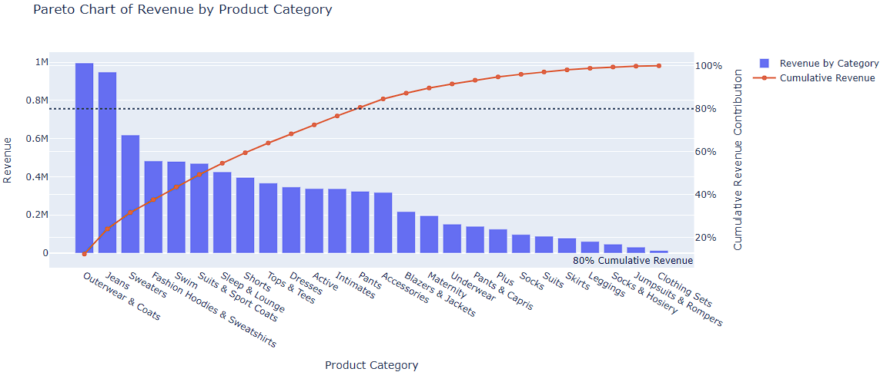
Market Insight: Revenue Concentration
High Concentration
12/26 categories generate 76.64% of total revenue ($6.2M).
Value-Driven: Outerwear & Coats ($995K, 6,499 orders).
Volume-Driven: Jeans (9.3K orders) & Intimates (9.2K orders, $36 AOV).
Seasonality Risk
Revenue is primarily seasonal (cold weather). Swimwear shows potential for summer growth.

Slide 7
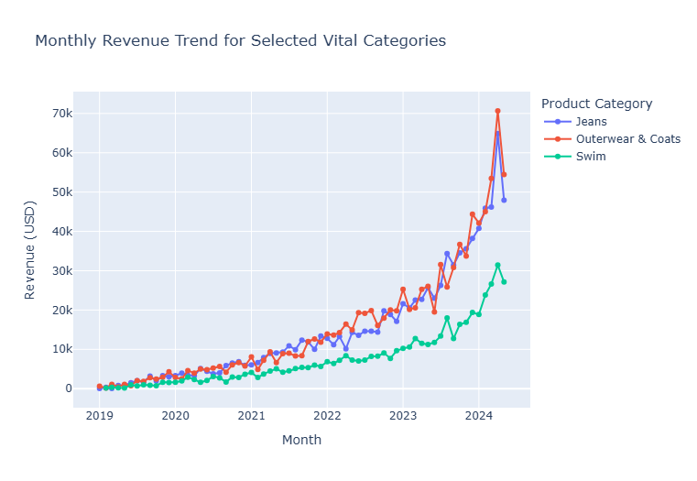
Revenue Trends by Key Categories
1. Strategic "Tri-pillar" Structure
Resilient revenue model driven by synergy between Jeans, Outerwear, and Swimwear.
2. Jeans: Non-seasonal Anchor
Remarkably flat revenue ($45K-$55K monthly) provides a reliable baseline cash flow.
Value: Backbone of platform stability.
3. Seasonal Hedging
Perfect inverse correlation: Outerwear peaks in Winter while Swimwear fills the mid-year gap.
Monthly Revenue Trends ($) by Core Product Category

Slide 8
02
DECODING THE "LEAKY BUCKET" SYNDROME: WHEN MARKETING FOCUSES ON "HUNTING" BUT NEGLECTS "FARMING"

Slide 9

RFM Segmentation Methodology
Core RFM Metrics
🕒 Recency (R): Days since last transaction. (Engagement freshness)
🔁 Frequency (F): Total number of orders. (Brand loyalty)
💰 Monetary (M): Total lifetime expenditure. (Financial contribution)
Scoring Scale (Rank 1 - 5)
Score 5 (Premium Asset)
Highly active, high-frequency, top-tier spenders representing the most valuable customers.
Score 1 (Dormant/Low-Value)
Prolonged absence, single-purchase buyers with minimal lifetime platform spend.
Applied Methodology
We used the Quintile Method to partition The Look's customer base into 5 equal brackets, each representing 20% of the population.
Matrix Complexity
Generated 125 MECE profiles (111 to 555) to map every possible customer lifecycle behavior.

Slide 10
Detailed RFM Segment Definitions
Champions
Scores: 555, 554, 544, 454...
DNA: Purchased recently, frequent, high spend.
Action: Reward, early access, referrals.
Loyal
Scores: 543, 444, 435, 355...
DNA: Regular orders, promo engaged.
Action: Upsell, personalized, reviews.
Potential Loyalist
Scores: 553, 551, 552, 541...
DNA: Recently purchased, good spending.
Action: Loyalty programs, engagement.
Promising
Scores: 525, 524, 523, 522...
DNA: Former loyal, recently inactive.
Action: Offer discounts, win back.
New Customers
Scores: 512, 511, 422, 421...
DNA: Single or very recent transaction.
Action: Onboarding, relationship building.
Needs Attention
Scores: 535, 534, 443, 434...
DNA: Core customers inactive >1 month.
Action: Limited promos, personalization.
At Risk / Can't Lose
Scores: R low (1,2), F/M mid-high
DNA: High historical value, now dormant.
Action: Regain through high personalization.
Hibernating
Scores: Low R, low F, low/mid M
DNA: Purchase long ago, still interactive.
Action: Re-engage with specific discounts.
Lost
Scores: 111, 112, 121...
DNA: Long absence, zero interaction.
Action: Exclude from outreach campaigns.

Slide 11
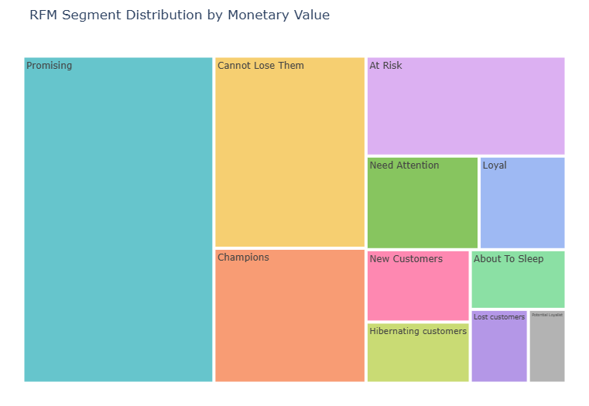
RFM Segmentation Insights
1. Revenue Instability
Platform revenue is entirely dependent on continuous new customer acquisition. Most customers churn after 1-2 transactions.
2. High-Value Attrition
13,000+ customers are 'Hibernating' or 'Lost'. The high-spend 'Cannot Lose Them' segment ($1.33M) is inactive.
3. The "One-Hit Wonder"
The 18.51% CR is inflated by impulse buyers who leave due to poor post-purchase experiences.

Slide 12

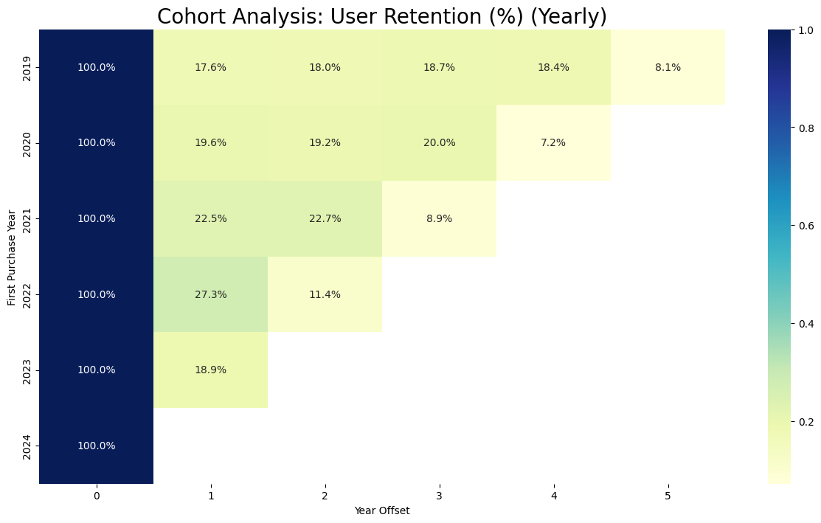
Multi-Year Cohort Retention Analysis
THE CORE FINDING: Multi-year cohort analysis exposes a chronic, platform-wide retention deficit across all historical brackets.
Upon entering Year 1, the platform experiences an immediate and severe drop-off, with retention capped at a stagnant 18% – 27% range, followed by a continuous decay.
Empirical Evidence (Data Proof-Points)
2019 Cohort
Retention collapsed to 17.6% in Year 1 and progressively degraded to a marginal 8.1% by Year 5.
2020 Cohort
Replicated an identical decay curve, capturing only 19.6% in Year 1 and dropping to a trough of 7.2% by Year 4.

Slide 13

Executive Summary: Refuting Loyalty Hypothesis
The hypothesis that high conversion is driven by loyalty is empirically refuted.
RFM Analysis Insights
The platform excels at acquisition but fails at retention.
Dominant Segments 'New Customers' and 'Promising' (~29k individuals) drive primary revenue.
Retention Gap The loyal 'Champions' segment is exceptionally small.
Cohort Analysis Insights
Platform-wide retention deficit confirmed across all years.
Year 1 Drop-off Retention plummets to 18% – 27% by the second year.
Long-term Attrition Continuous decay confirms existing customers aren't a sustainable foundation.

Slide 14
03
USER FLOW ANALYSIS

Slide 15
Critical Cart Abandonment
 | Total session | Product -> Cart (%Drop-off) | Cart -> Purchase (%Drop-off) | Total Journey Failure Rate
Adwords | 20.3690 | 36,80 | 58,00 | 73,50
Email | 30.6377 | 36,80 | 58,00 | 73,40
Facebook | 68.518 | 36,40 | 57,90 | 73,20
Organic | 33.753 | 36,80 | 58,20 | 73,60
YouTube | 68.524 | 36,70 | 58,10 | 73,50
Platform Average | 680.862 | 36,80 | 58,00 | 73,40
Checkout Friction Analysis
The platform suffers from a 73.4% Total Journey Failure Rate. While interest is high, the transition from intent to ownership is broken.
Key Friction Point:
Standard drop-off at product page (~36%)
Catastrophic 58% abandonment at checkout
Systemic Implications:
Uniform behavior across all traffic sources confirms this is a UX/Platform failure, not a marketing targeting issue.

Slide 16
04
REVENUE MAXIMIZATION STRATEGY

Slide 17
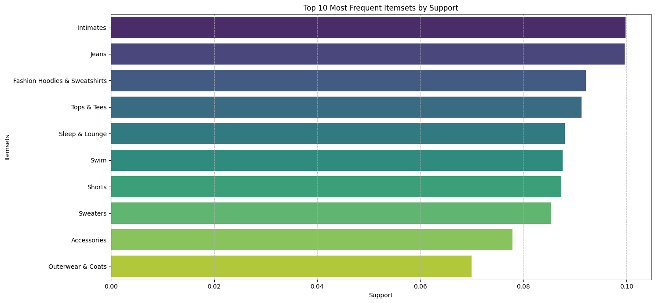
Top Frequent Itemsets by Support
Leading Itemsets
The chart shows that Intimates and Jeans are the most frequent, each with nearly 10% support.
Other popular categories (>8%) include Fashion Hoodies, Tops, Sleepwear, Swim, and Shorts.
Support Distribution
Distribution is relatively even among top categories.
Outerwear & Coats represents the lower end of the top 10 list at approximately 7% support.

Slide 18
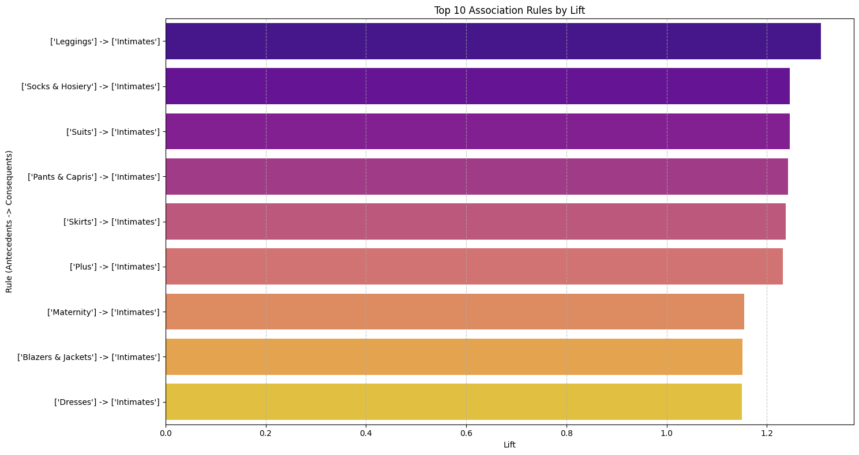
Top 10 Association Rules by Lift
Key Insights
[Lingerie] → [Intimates] shows the highest lift, suggesting a very strong association between these categories.
Items like Socks & Hosiery and Suits are also frequently bought together with Intimates.
The lift values range from approximately 1.1 to 1.3, indicating positive correlation across the top 10 rules.

Slide 19
STRATEGIC ACTION PLAN: THE LOOK ECOMMERCE
Objective: Plugging conversion leaks and pivoting from aggressive acquisition to sustainable retention.
PRIORITY 1: PLUGGING THE "LEAKY BUCKET"
Goal: Recover lost revenue and minimize operational deficit.
1. Checkout Friction
Guest Checkout: Salvage 60% drop-off.
Transparent Cost Breakdown.
Abandoned Cart Recovery.
2. Supply Chain Audit
Rationalize Intimates/Jeans suppliers.
Enhanced Size & Fit Tools.
PRIORITY 2: MAXIMIZING REVENUE PER USER
Goal: Increase AOV through data-driven cross-selling.
3. Cross-selling Strategy
Recommendation Engine Integration: "Frequently Bought Together" widget.
Strategic "Super Bundles": Targeted to increase the $84.88 AOV baseline.
PRIORITY 3: PIVOT TO RETENTION
Goal: Address 2%-5% Retention Rate bottleneck.
4. Marketing Re-allocation
20-30% budget shift to Win-back.
Launch Tiered Loyalty Program.
5. Intelligent Inventory
Maintain Jeans Safety Stock.
Seasonal Hedging: Outerwear/Swim.

Slide 20
THANK YOU!
FOR WATCHING MY PRESENTATION

